Slide 1
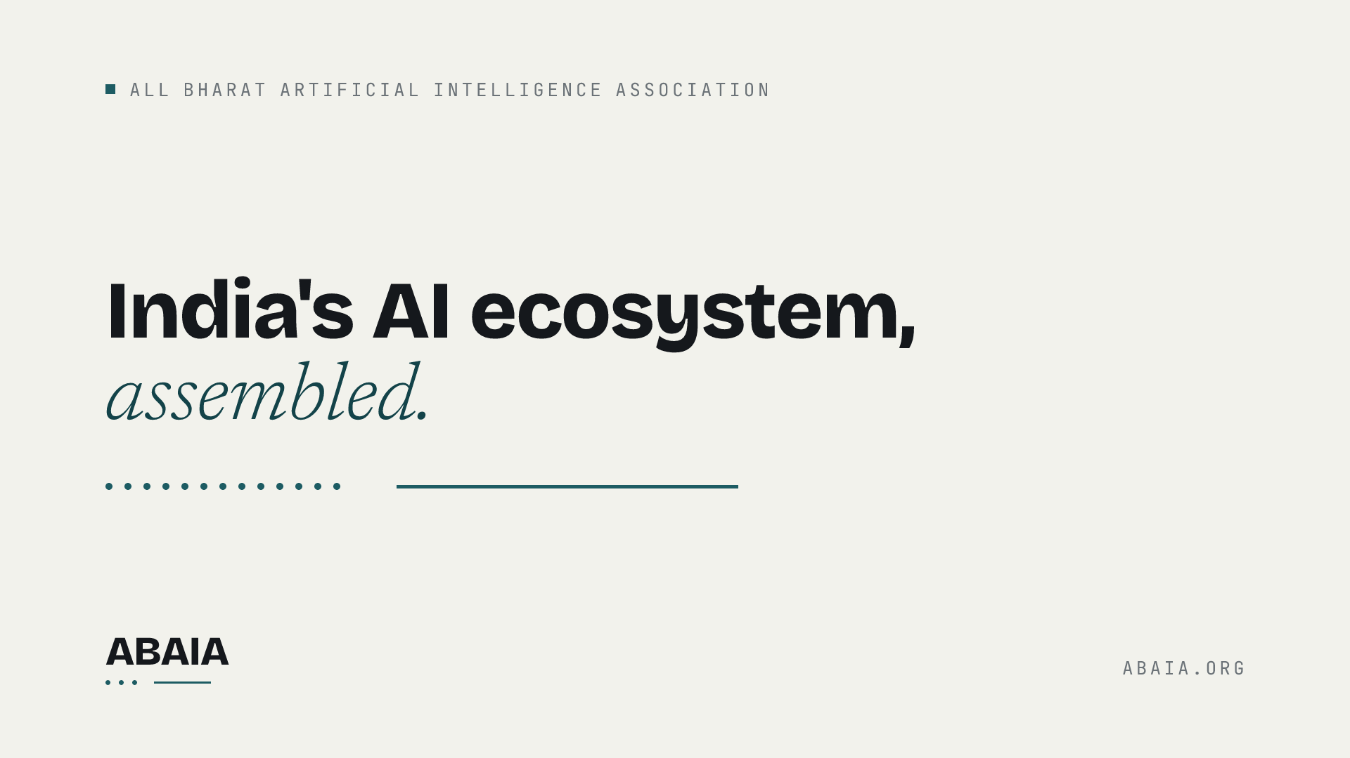

Slide 2
BEFORE YOU START
Install three fonts, then delete this slide.
Bricolage Grotesque — headings. fonts.google.com/specimen/Bricolage+Grotesque
Newsreader — body text. fonts.google.com/specimen/Newsreader
JetBrains Mono — labels, data, small caps. jetbrains.com/lp/mono
All three are open-source and free. Without them PowerPoint substitutes and the deck stops looking like ABAIA. Peacock #1D5C63 carries the brand — links, CTAs, the assembly rule. Amber #B4690E means live state only — open calls, active status — and never decoration.
ABAIA
ABAIA.ORG

Slide 3
Section title
One line on what this section argues.

Slide 4
THE ARGUMENT
A claim in one line, with a number in it.
Supporting paragraph. Keep it to what a reader can check. If a claim has no number attached, either find the number or cut the claim — the register and the marketplace run on that rule and decks do not get an exemption.
Pull-out, evidence, or a quotation that does the work.
ABAIA
ABAIA.ORG

Slide 5
FOUR PILLARS
What the association exists to do.
Public understanding
Collaboration
Enterprise adoption
Startup funding
Webinars, events and workshops that make AI legible.
A working network that shares problems, introductions, results.
Concrete use cases inside enterprise workflows.
Backing early-stage AI companies with operator capital.
ABAIA
ABAIA.ORG

Slide 6
What we are asking for.
info@abaia.org
abaia.org
ABAIA
A NATIONAL NON-PROFIT ASSOCIATION

